Slide 1
Lecture 4: Requirements Engineering

Slide 2
Requirements engineering
The process of establishing the services that a customer requires from a system and the constraints under which it operates and is developed.
The system requirements are the descriptions of the system services and constraints that are generated during the requirements engineering process.

Slide 3
Types of requirement
User requirements
Statements in natural language plus diagrams of the services the system provides and its operational constraints written for customers.
System requirements
A structured document setting out detailed descriptions of the system’s functions, services and operational constraints. Defines what should be implemented so may be part of a contract between client and contractor.

Slide 4
System Requirement
It may range from a high-level abstract statement of a service or of a system constraint to a detailed formal or mathematical functional specification.
This is inevitable as requirements may serve a dual function
May be the basis for a bid for a contract - therefore must be open to interpretation;
May be the basis for the contract itself - therefore must be defined in detail;
Both these statements may be called requirements.

Slide 5
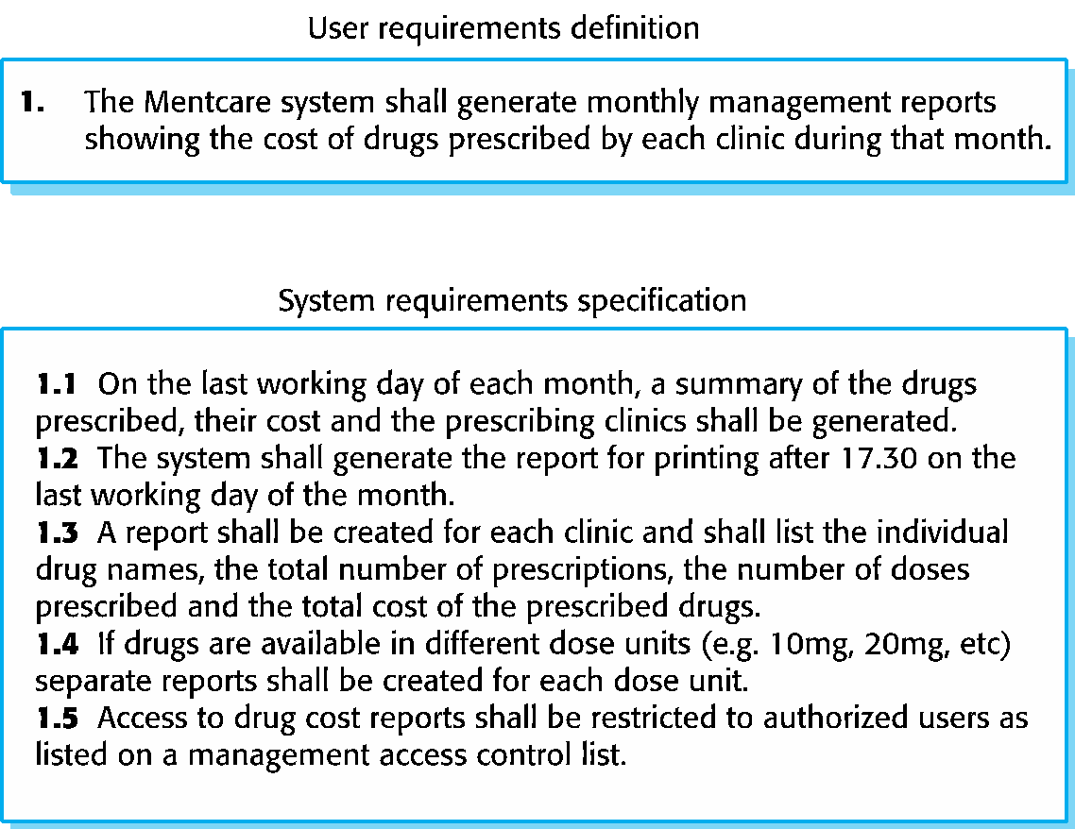
User and system requirements

Slide 6
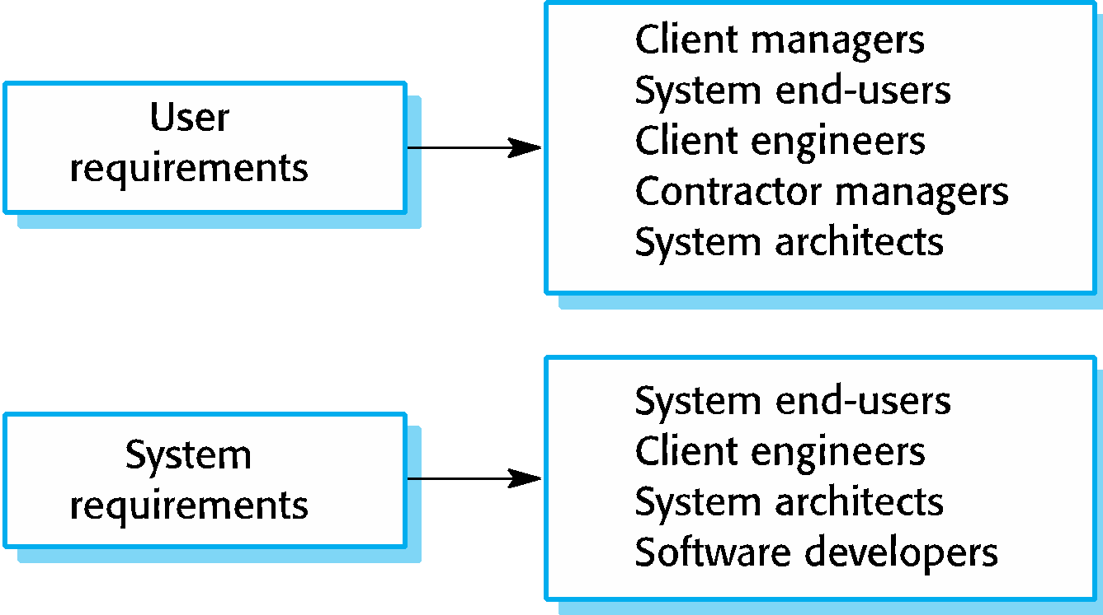
Readers of different types of requirements specification

Slide 7
System stakeholders
Any person or organization who is affected by the system in some way and so who has a legitimate interest
Stakeholder types
End users
System managers
System owners
External stakeholders

Slide 8
Functional requirements
Describe functionality or system services.
Depend on the type of software, expected users and the type of system where the software is used.
Functional user requirements may be high-level statements of what the system should do.
Functional system requirements should describe the system services in detail.
Statements of services the system should provide, how the system should react to particular inputs and how the system should behave in particular situations.
May state what the system should not do.

Slide 9
Non-functional requirements
These define system properties and constraints e.g. reliability, response time and storage requirements. Constraints are I/O device capability, system representations, etc.
Process requirements may also be specified mandating a particular IDE, programming language or development method.
Non-functional requirements may be more critical than functional requirements. If these are not met, the system may be useless.
Constraints on the services or functions offered by the system such as
timing constraints, constraints on the development process, standards, etc.
Often apply to the system as a whole rather than individual features or
services.

Slide 10
Examples of nonfunctional requirements in the Mentcare system
Product requirement The Mentcare system shall be available to all clinics during normal working hours (Mon–Fri, 0830–17.30). Downtime within normal working hours shall not exceed five seconds in any one day. Organizational requirement Users of the Mentcare system shall authenticate themselves using their health authority identity card. External requirement The system shall implement patient privacy provisions as set out in HStan-03-2006-priv.

Slide 11
Metrics for specifying nonfunctional requirements
Property | Measure
Speed | Processed transactions/second User/event response time Screen refresh time
Size | Mbytes Number of ROM chips
Ease of use | time NumTraining ber of help frames
Reliability | Mean time to failure Probability of unavailability Rate of failure occurrence Availability
Robustness | Time to restart after failure Percentage of events causing failure Probability of data corruption on failure
Portability | Percentage of target dependent statements Number of target systems

Slide 12
Requirements engineering processes
The processes used for RE vary widely depending on the application domain, the people involved and the organisation developing the requirements.
However, there are a number of generic activities common to all processes
Requirements elicitation;
Requirements analysis;
Requirements validation;
Requirements management.
In practice, RE is an iterative activity in which these processes are interleaved.

Slide 13
Requirements elicitation and analysis
Sometimes called requirements elicitation or requirements discovery.
Involves technical staff working with customers to find out about the application domain, the services that the system should provide and the system’s operational constraints.
May involve end-users, managers, engineers involved in maintenance, domain experts, trade unions, etc. These are called stakeholders.

Slide 14
Requirements elicitation
Software engineers work with a range of system stakeholders to find out about the application domain, the services that the system should provide, the required system performance, hardware constraints, other systems, etc.
Stages include:
Requirements discovery,
Requirements classification and organization,
Requirements prioritization and negotiation,
Requirements specification.

Slide 15
Problems of requirements elicitation
Stakeholders don’t know what they really want.
Stakeholders express requirements in their own terms.
Different stakeholders may have conflicting requirements.
Organisational and political factors may influence the system requirements.
The requirements change during the analysis process. New stakeholders may emerge and the business environment may change.

Slide 16
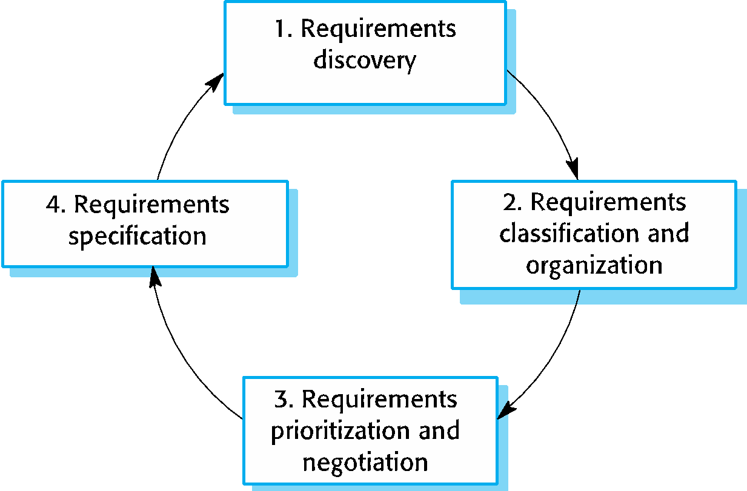
The requirements elicitation and analysis process

Slide 17
Process activities
Requirements discovery
Interacting with stakeholders to discover their requirements. Domain requirements are also discovered at this stage.
The process of gathering information about the required and existing systems and
distilling the user and system requirements from this information.
Interaction is with system stakeholders from managers to external regulators.
Systems normally have a range of stakeholders.
Requirements classification and organisation
Groups related requirements and organises them into coherent clusters.
Prioritisation and negotiation
Prioritising requirements and resolving requirements conflicts.
Requirements specification
Requirements are documented and input into the next round of the spiral.

Slide 18
Interviewing
Formal or informal interviews with stakeholders are part of most RE processes.
Types of interview
Closed interviews based on pre-determined list of questions
Open interviews where various issues are explored with stakeholders.
Effective interviewing
Be open-minded, avoid pre-conceived ideas about the requirements and are willing to listen to stakeholders.
Prompt the interviewee to get discussions going using a springboard question, a requirements proposal, or by working together on a prototype system.

Slide 19
Stories and scenarios
Scenarios and user stories are real-life examples of how a system can be used.
Stories and scenarios are a description of how a system may be used for a particular task.
Because they are based on a practical situation, stakeholders can relate to them and can comment on their situation with respect to the story.

Slide 20
Photo sharing in the classroom (iLearn)
Jack is a primary school teacher in Ullapool (a village in northern Scotland). He has decided that a class project should be focused around the fishing industry in the area, looking at the history, development and economic impact of fishing. As part of this, pupils are asked to gather and share reminiscences from relatives, use newspaper archives and collect old photographs related to fishing and fishing communities in the area. Pupils use an iLearn wiki to gather together fishing stories and SCRAN (a history resources site) to access newspaper archives and photographs. However, Jack also needs a photo sharing site as he wants pupils to take and comment on each others’ photos and to upload scans of old photographs that they may have in their families. Jack sends an email to a primary school teachers group, which he is a member of to see if anyone can recommend an appropriate system. Two teachers reply and both suggest that he uses KidsTakePics, a photo sharing site that allows teachers to check and moderate content. As KidsTakePics is not integrated with the iLearn authentication service, he sets up a teacher and a class account. He uses the iLearn setup service to add KidsTakePics to the services seen by the pupils in his class so that when they log in, they can immediately use the system to upload photos from their mobile devices and class computers.

Slide 21
Scenarios
A structured form of user story
Scenarios should include
A description of the starting situation;
A description of the normal flow of events;
A description of what can go wrong;
Information about other concurrent activities;
A description of the state when the scenario finishes.

Slide 22
Uploading photos iLearn)
Initial assumption: A user or a group of users have one or more digital photographs to be uploaded to the picture sharing site. These are saved on either a tablet or laptop computer. They have successfully logged on to KidsTakePics.
Normal: The user chooses upload photos and they are prompted to select the photos to be uploaded on their computer and to select the project name under which the photos will be stored. They should also be given the option of inputting keywords that should be associated with each uploaded photo. Uploaded photos are named by creating a conjunction of the user name with the filename of the photo on the local computer.
On completion of the upload, the system automatically sends an email to the project moderator asking them to check new content and generates an on-screen message to the user that this has been done.

Slide 23
Uploading photos
What can go wrong?
No moderator is associated with the selected project. An email is automatically generated to the school administrator asking them to nominate a project moderator. Users should be informed that there could be a delay in making their photos visible.
Photos with the same name have already been uploaded by the same user. The user should be asked if they wish to re-upload the photos with the same name, rename the photos or cancel the upload. If they chose to re-upload the photos, the originals are overwritten. If they chose to rename the photos, a new name is automatically generated by adding a number to the existing file name.
Other activities: The moderator may be logged on to the system and may approve photos as they are uploaded.
System state on completion: User is logged on. The selected photos have been uploaded and assigned a status ‘awaiting moderation’. Photos are visible to the moderator and to the user who uploaded them.

Slide 24
Ways of writing a system requirements specification
Notation | Description
Natural language | The requirements are written using numbered sentences in natural language. Each sentence should express one requirement.
Structured natural language | The requirements are written in natural language on a standard form or template. Each field provides information about an aspect of the requirement.
Design description languages | This approach uses a language like a programming language, but with more abstract features to specify the requirements by defining an operational model of the system. This approach is now rarely used although it can be useful for interface specifications.
Graphical notations | Graphical models, supplemented by text annotations, are used to define the functional requirements for the system; UML use case and sequence diagrams are commonly used.
Mathematical specifications | These notations are based on mathematical concepts such as finite-state machines or sets. Although these unambiguous specifications can reduce the ambiguity in a requirements document, most customers don’t understand a formal specification. They cannot check that it represents what they want and are reluctant to accept it as a system contract

Slide 25
Requirements and design
In principle, requirements should state what the system should do and the design should describe how it does this.
In practice, requirements and design are inseparable
A system architecture may be designed to structure the requirements;
The system may inter-operate with other systems that generate design requirements;
The use of a specific architecture to satisfy non-functional requirements may be a domain requirement.
This may be the consequence of a regulatory requirement.

Slide 26
Form-based specifications
Definition of the function or entity.
Description of inputs and where they come from.
Description of outputs and where they go to.
Information about the information needed for the computation and other entities used.
Description of the action to be taken.
Pre and post conditions (if appropriate).
The side effects (if any) of the function.

Slide 27
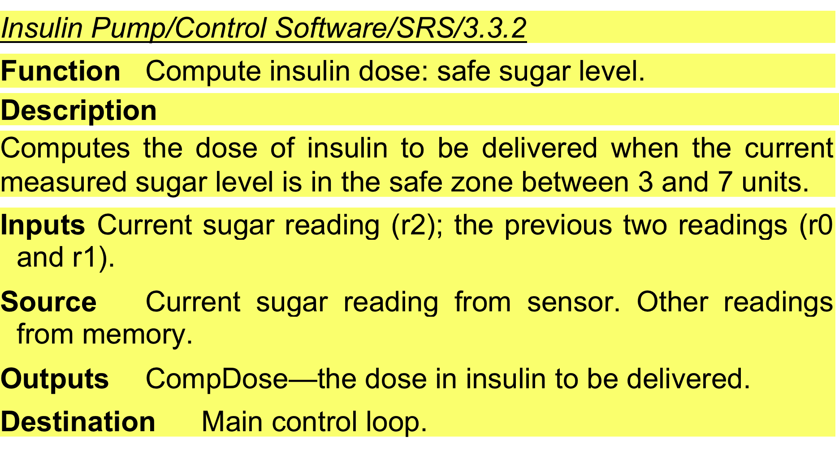
A structured specification of a requirement for an insulin pump

Slide 28
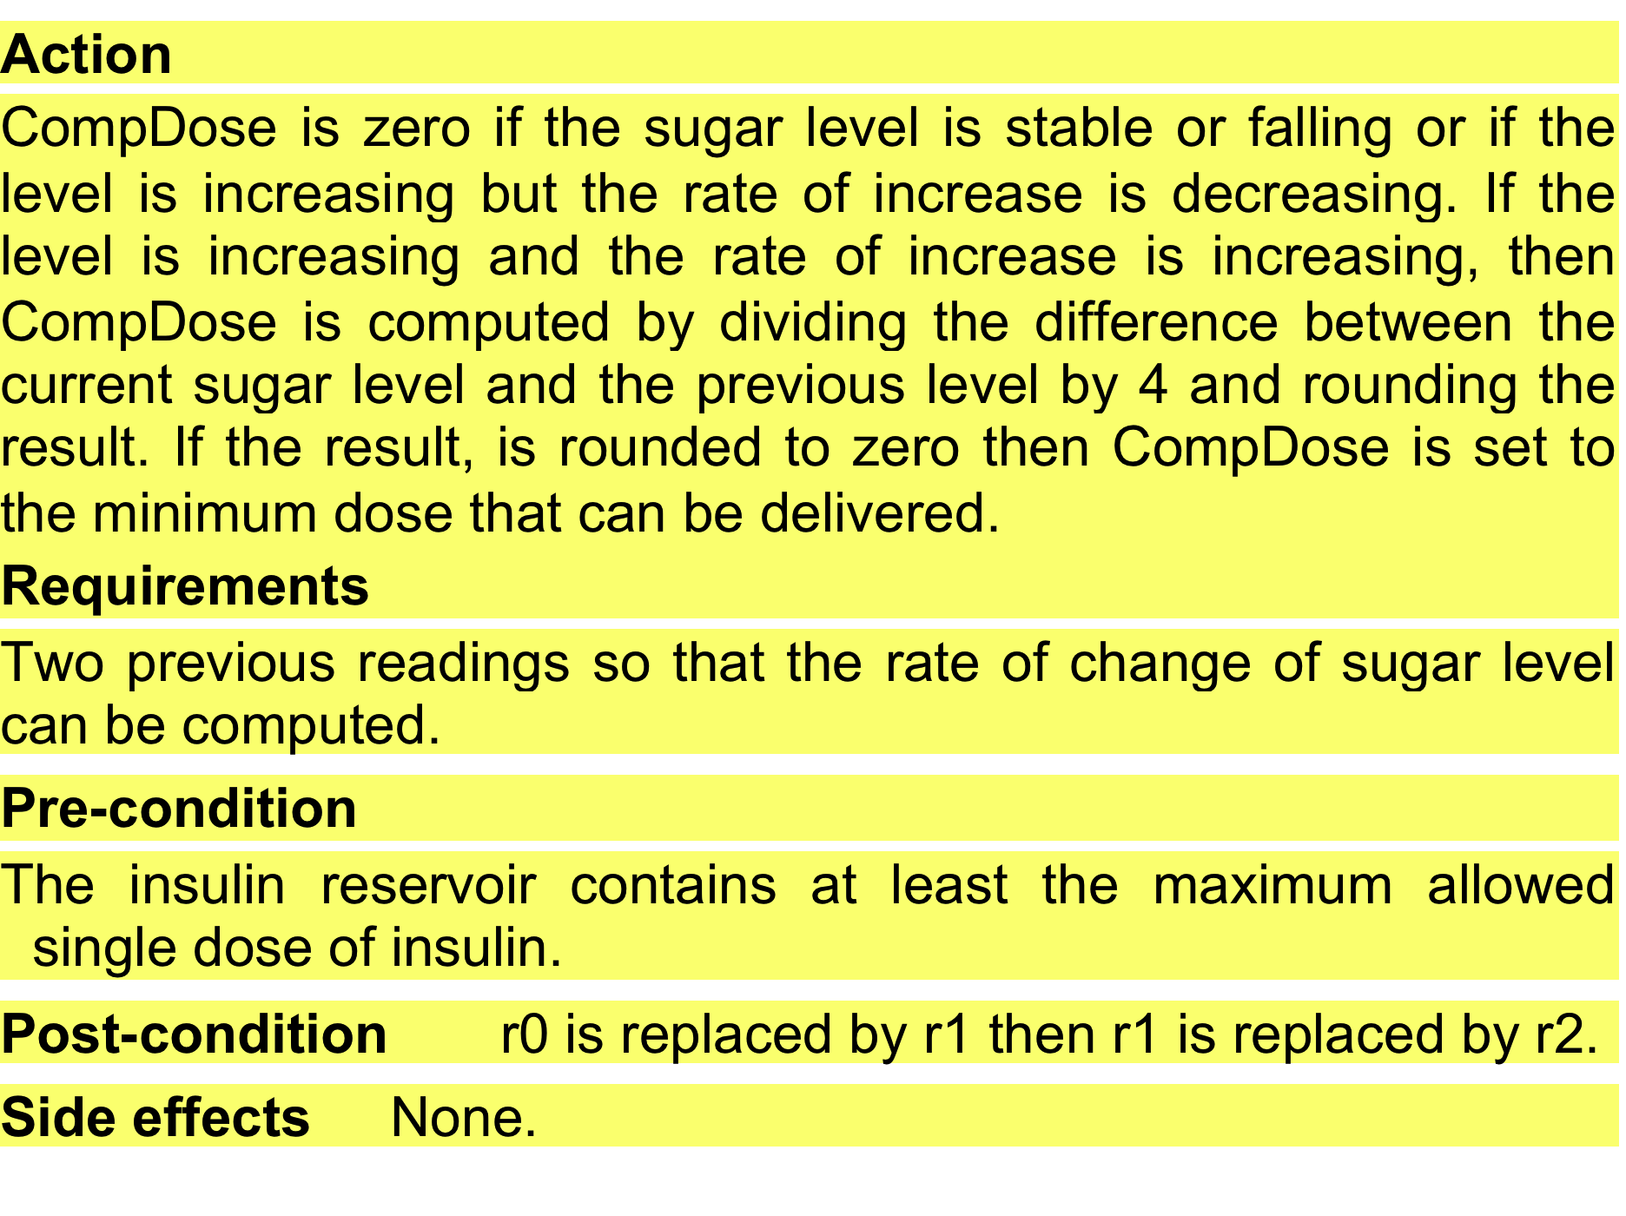
A structured specification of a requirement for an insulin pump

Slide 29
Tabular specification of computation for an insulin pump
Condition | Action
Sugar level falling (r2 < r1) | CompDose = 0
Sugar level stable (r2 = r1) | CompDose = 0
Sugar level increasing and rate of increase decreasing ((r2 – r1) < (r1 – r0)) | CompDose = 0
Sugar level increasing and rate of increase stable or increasing ((r2 – r1) ≥ (r1 – r0)) | CompDose = round ((r2 – r1)/4) If rounded result = 0 then CompDose = MinimumDose

Slide 30
The software requirements document
The software requirements document is the official statement of what is required of the system developers.
Should include both a definition of user requirements and a specification of the system requirements.
It is NOT a design document. As far as possible, it should set of WHAT the system should do rather than HOW it should do it.

Slide 31
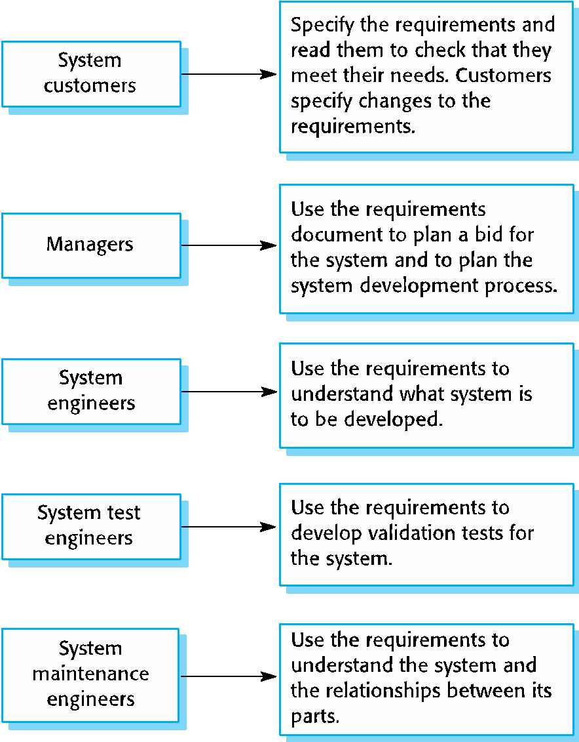
Users of a requirements document

Slide 32
The structure of a requirements document
Chapter | Description
Preface | This should define the expected readership of the document and describe its version history, including a rationale for the creation of a new version and a summary of the changes made in each version.
Introduction | This should describe the need for the system. It should briefly describe the system’s functions and explain how it will work with other systems. It should also describe how the system fits into the overall business or strategic objectives of the organization commissioning the software.
Glossary | This should define the technical terms used in the document. You should not make assumptions about the experience or expertise of the reader.
User requirements definition | Here, you describe the services provided for the user. The nonfunctional system requirements should also be described in this section. This description may use natural language, diagrams, or other notations that are understandable to customers. Product and process standards that must be followed should be specified.
System architecture | This chapter should present a high-level overview of the anticipated system architecture, showing the distribution of functions across system modules. Architectural components that are reused should be highlighted.

Slide 33
Requirements validation
Concerned with demonstrating that the requirements define the system that the customer really wants.
Requirements error costs are high so validation is very important
Fixing a requirements error after delivery may cost up to 100 times the cost of fixing an implementation error.

Slide 34
Requirements checking
Validity. Does the system provide the functions which best support the customer’s needs?
Consistency. Are there any requirements conflicts?
Completeness. Are all functions required by the customer included?
Realism. Can the requirements be implemented given available budget and technology
Verifiability. Can the requirements be checked?

Slide 35
Requirements validation techniques
Requirements reviews
Systematic manual analysis of the requirements.
Prototyping
Using an executable model of the system to check requirements. Covered in Chapter 2.
Test-case generation
Developing tests for requirements to check testability.

Slide 36
Review checks
Verifiability
Is the requirement realistically testable?
Comprehensibility
Is the requirement properly understood?
Traceability
Is the origin of the requirement clearly stated?
Adaptability
Can the requirement be changed without a large impact on other requirements?

